Slide 1
Storm Identification
Using 2017 as an example

Slide 2
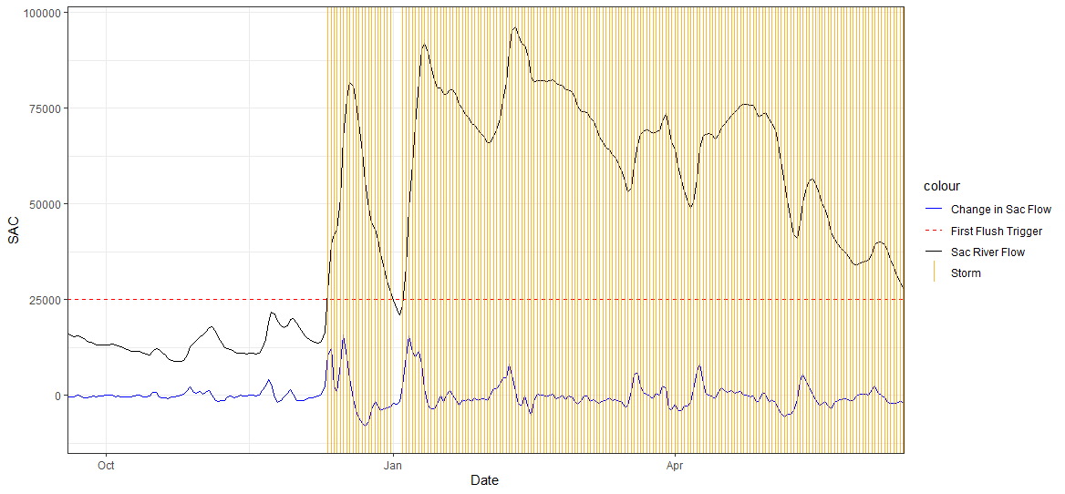
3-day average Sac flow > 25000

Slide 3
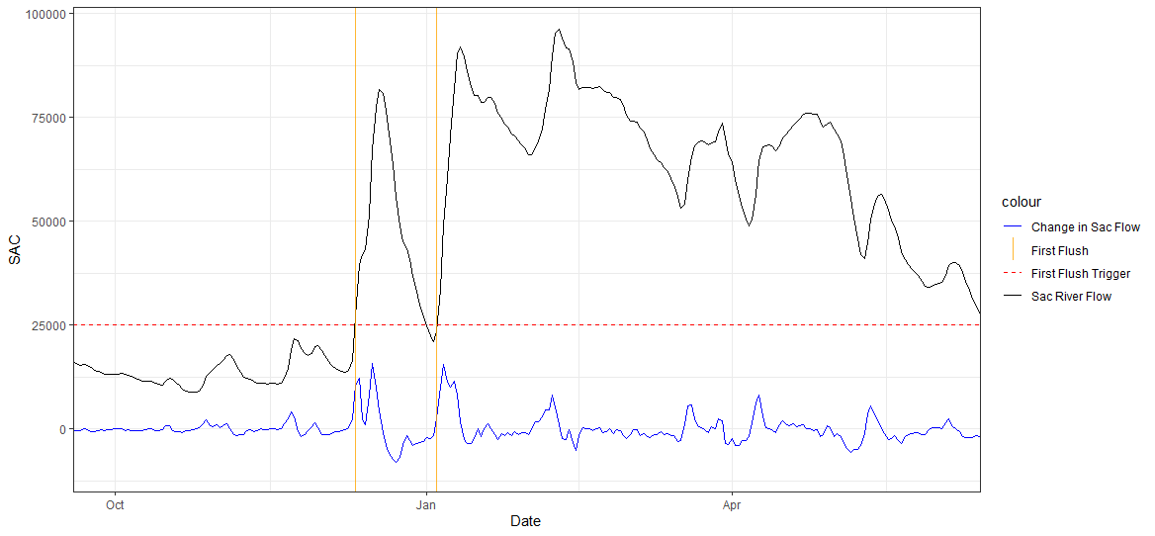
First day that the 3-day average is above 25000

Slide 4
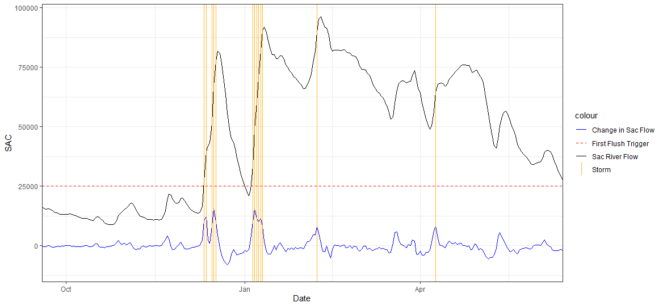
Rate of change in Sac flow > 6500 (95th percentile)

Slide 5
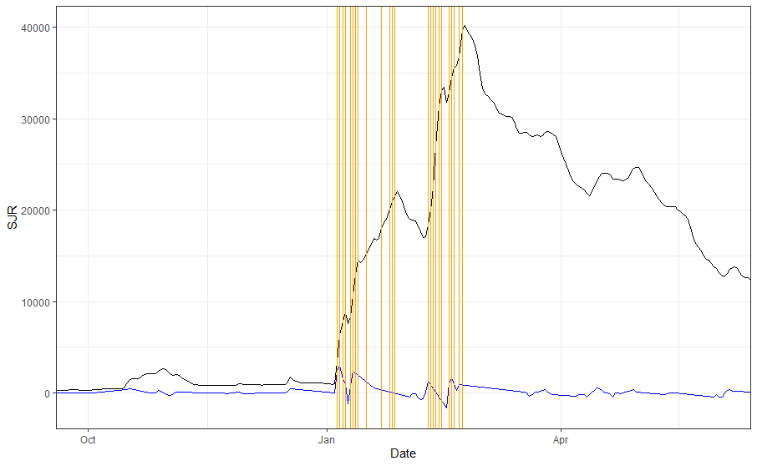
Same thing on the San Joaquin

Slide 6
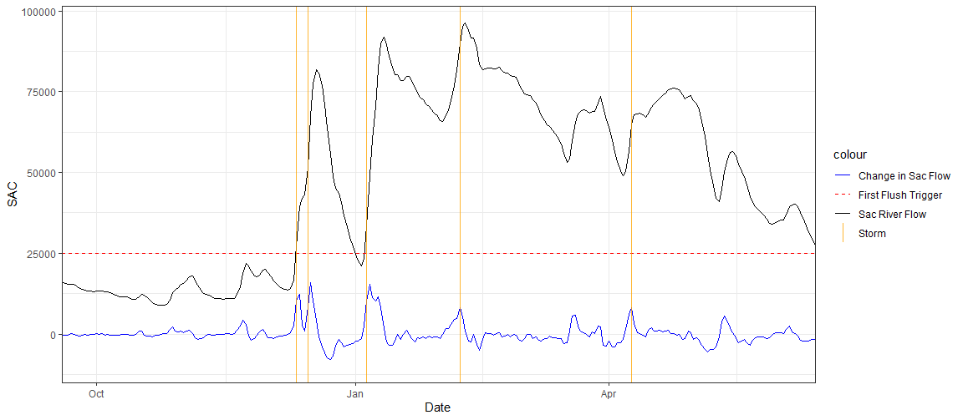
First day that the rate of change in Sac fow is > 6500

Slide 7
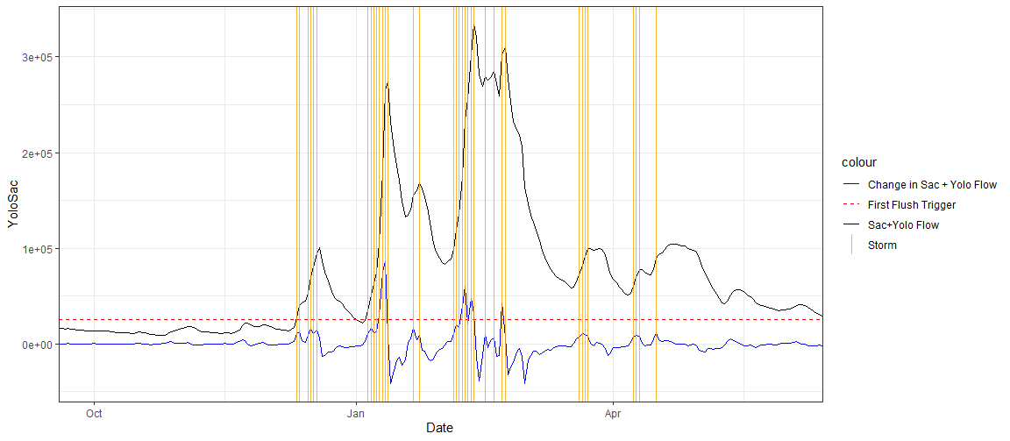
Rate of Change in Yolo + Sac > 6500

Slide 8
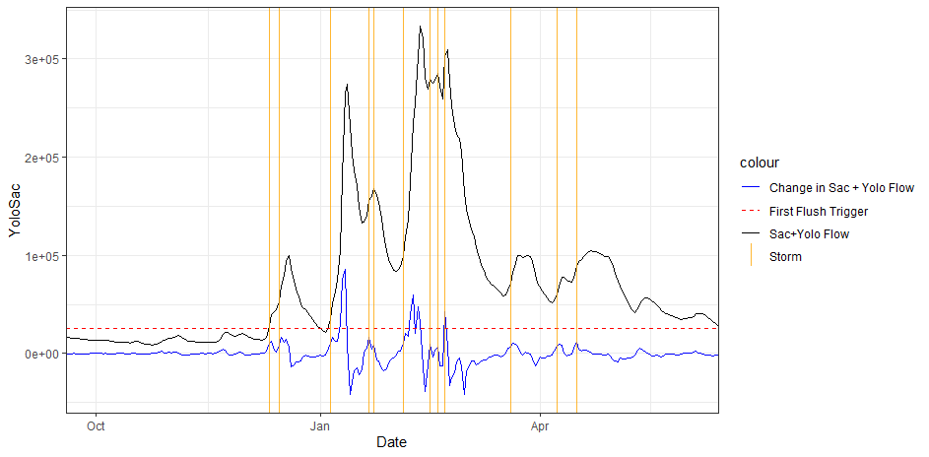
First day ROC in Sac+Yolo > 6500

Slide 9
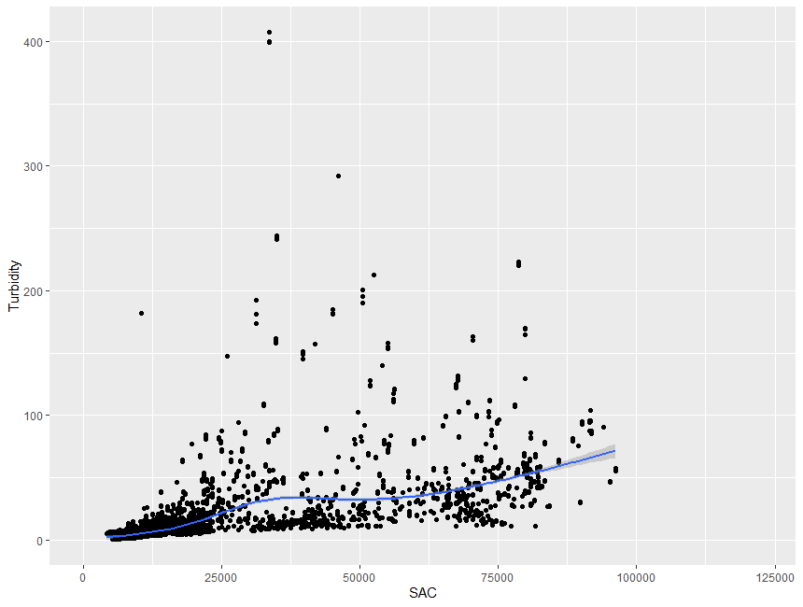
Turbidity versus flow at Freport

Slide 10
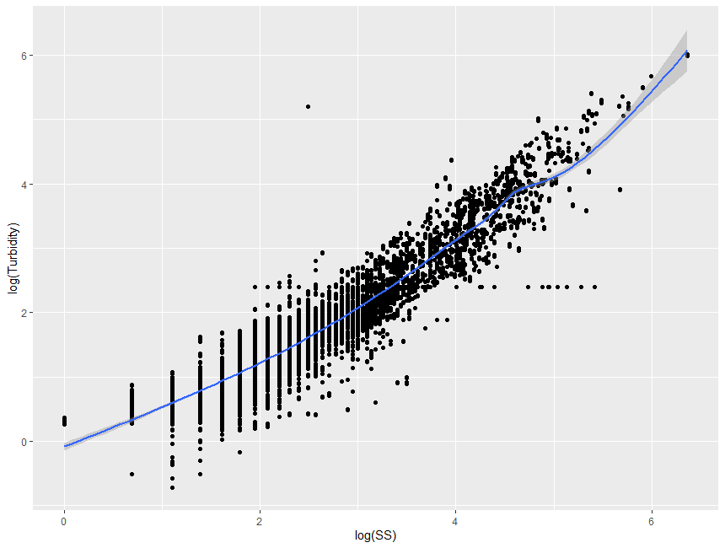
Turbidity x suspended sediment at Freport

Slide 11
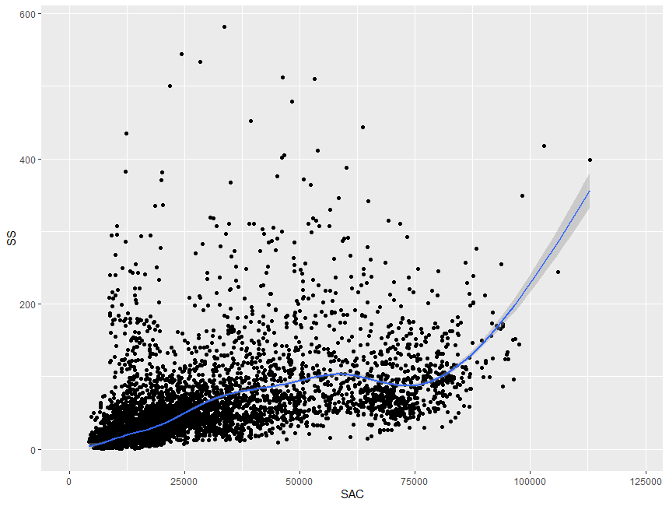
SS x flow at freport
Notes:
Break up by first event of season versus later events.

Slide 12
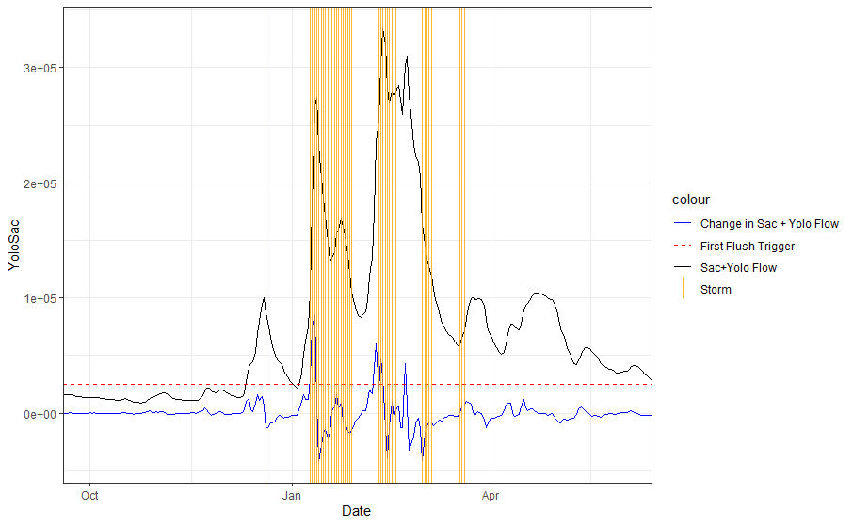
Flow > 25000 AND 3-day Turbidity >50

